Slide 1
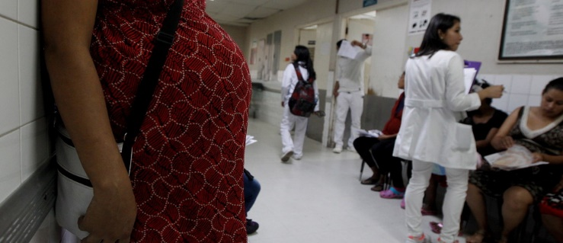
Modeling Maternal Mortality Rates (MMR)
Data Science Part Time Course
Rebecca Minich
11.29.16
https://assets.weforum.org/article/image/large_b05pCeiWDULOlBGVxJ52gFYvy6EPYx8R5WyOhPz1lNQ.jpg
Notes:
https://assets.weforum.org/article/image/large_b05pCeiWDULOlBGVxJ52gFYvy6EPYx8R5WyOhPz1lNQ.jpg

Slide 2
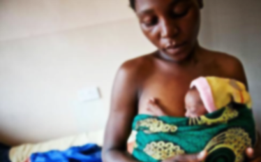
What factors contribute to global MMR?
PROBLEM STATEMENT:
Can I predict which socioeconomic and public health initiatives will decrease global maternal mortality rates?
http://healthreportereastafrica.com/wpontent/uploads/2016/01/premature-babies-ug.jpg
Notes:
Numerous sociopolitical factors contribute, you can see this at play with the individual states in the US. In regions with high MMRs,

Slide 3


Could other factors contribute to MMR?
Datasets
Maternal Mortality Rates (MMR):
Birth attendant
Antenatal (prenatal) care
Adolescent Birth Rates
Contraceptives modern methods
Abortion policy scale
Education: Primary School Enrollment
Technology: Cellphone Subscribers
War: Homicides
Health: Life Expectancy
Wealth: GNI Per Capita Data by Country(PPP)
Notes:
Main data sources for HDI data - Column 1: HDRO calculations based on data from UNDESA (2015), UNESCO Institute for Statistics (2015), United Nations Statistics Division (2015), World Bank (2015a), Barro and Lee (2014) and IMF (2015). Column 2: UNDESA (2015). Column 3: UNESCO Institute for Statistics (2015). Column 4: UNESCO Institute for Statistics (2015), Barro and Lee (2014), UNICEF Multiple Indicator Cluster Surveys and ICF Macro Demographic and Health Surveys. Column 5: World Bank (2015a), IMF (2015) and United Nations Statistics Division (2015). Column 6: Calculated based on data in columns 1 and 5.

Slide 4
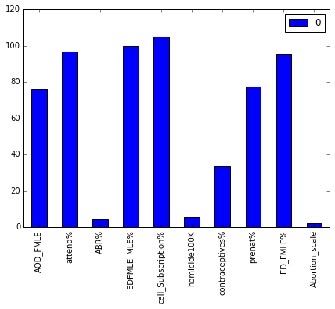
Dataframe and Feature Engineering
190 countries
12 different datasets, 33 total columns
Missing data filled with median values:

Slide 5
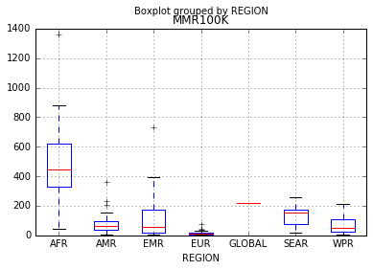
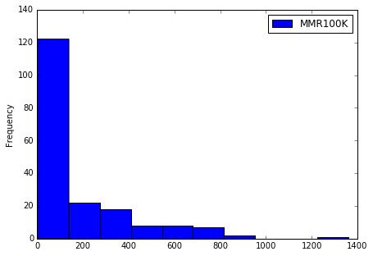
Response Variable Engineering
Regional MMR
MMR Frequency
MMR100K - Maternal deaths per 100,000 births
MMRClassifier - Created for logistic regression model based on min, max and 25, 50, 75% of MMR.
MMRBinary - Binary variable for logistic regression model.

Slide 6
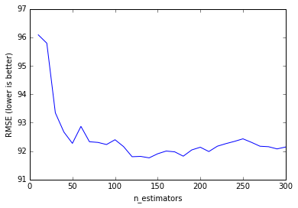
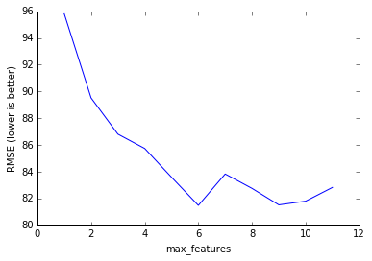
Optimizing Features:
Random Forest Regressor
Estimator Tuning
Feature Tuning
140
6
 | RMSE Null | RMSE Total | RMSE Optimized
MMR100K | 228.39 | 91.88 | 82.65
Table 2: Optimized demographics include: 'ABR%', 'AOD_FMLE', 'GNI', 'EDFMLE_MLE%', 'cell_Subscription%', 'attend%'. The Random Forest Regressor model was. Null RMSE is with y_predict = mean.
Notes:
for all demographics (CV=5, estimators=140)
for optimized features (CV=10, estimartors=130):

Slide 7
Model Comparisons
 | Null | Log Reg | Log Reg (Optimized) | Ran For | Ran For (Optimized)
MMRBinary | 0.526316 | 0.873684211 | 0.857894737 | 0.8895 | 0.8947
MMRClassifier | 0.268421 | 0.692464986 | 0.674336644 | 0.7558 | 0.7482
MMR100K (oob) | 0.052632 | Na | Na | 0.815* | 0.8348*
Table 2: Optimized demographics include: 'ABR%', 'AOD_FMLE', 'GNI', 'EDFMLE_MLE%', 'cell_Subscription%', 'attend%'. The Random Forest Classifier model was used for MMRBinary and MMRClassifier. *Random Forest Regressor was used as the model for MMR100K. Null accuracy scores are the percent chance of selecting the most frequent value (MMRBinary = 1, MMRClassifier = 2, MMR100K = 54).
All of the models improve null accuracy.
The random forest classifier performs better than the logistic regression model.
Reducing the number of demographics improves model accuracy.
*The random forest regressor model was used for MMR100K and is the only model run that produces MMR predictions.

Slide 8
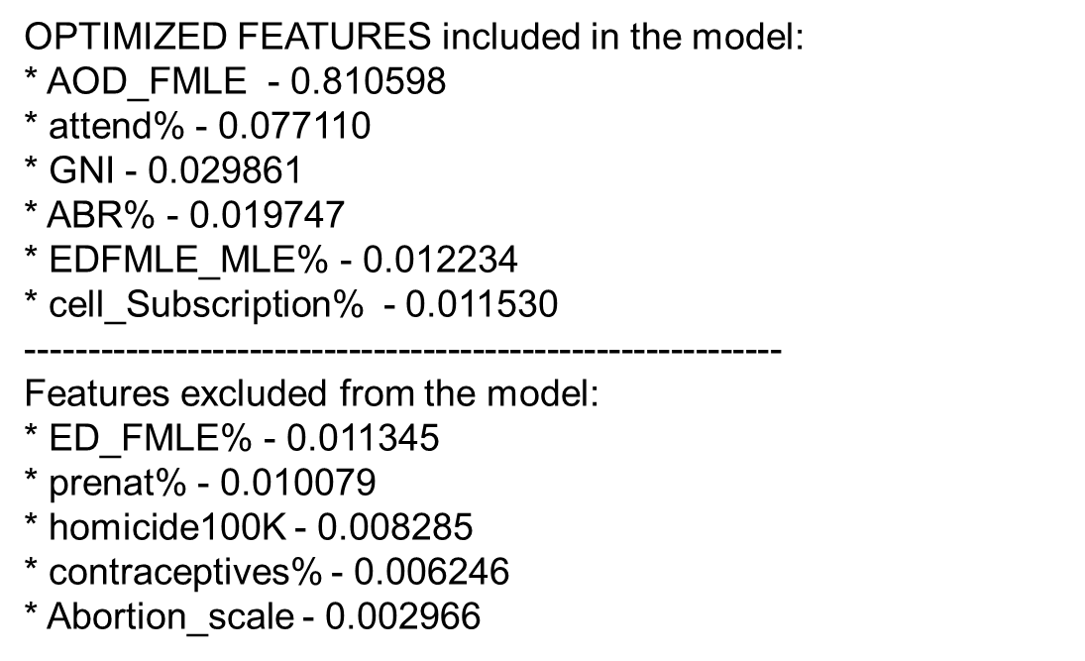
Conclusions
Demographic contributions to model:
Successful hypothesis: Education
Surprising outcomes: Abortion policy, cell phone subscriptions
Future Work
Build a model that lacks well known causal demographics and determine the predictability.
Add more demographics from the WHO website.
Notes:
Although the social burdens alone make this an important public health issue, there is also a steep economic cost HL in the form of disability, loss of days worked and the cost of devices to improve hearing. To better understand the progression of AHL I am going to describe mammalian auditory transduction

